Slide 1
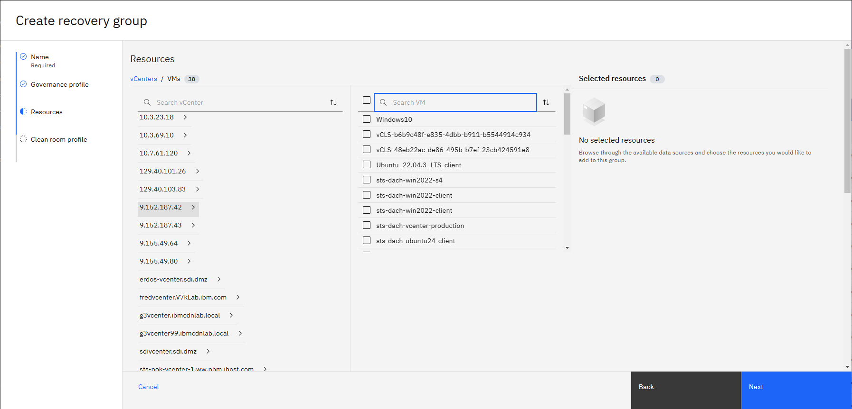
IDEA: Allow searching / filtering for VMware Tags and VMware folders when creating a Recovery group

Slide 2
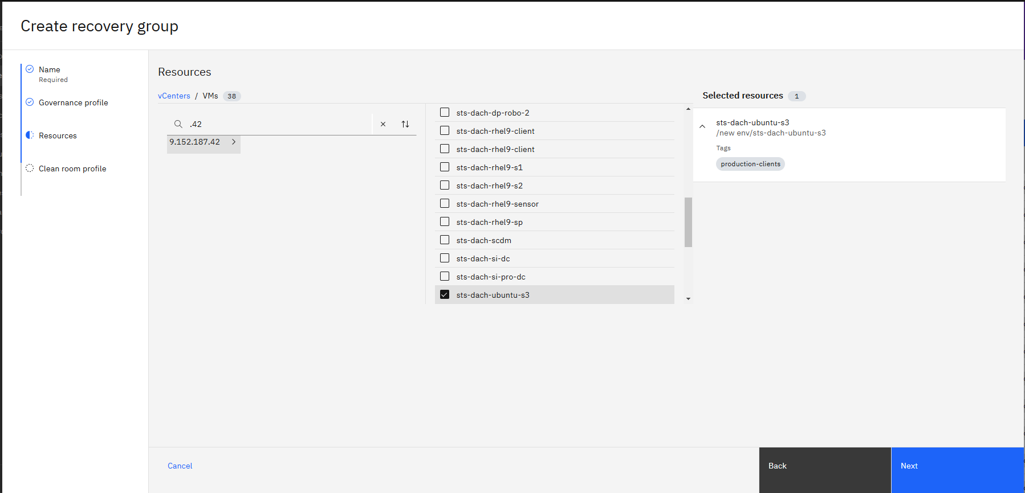
Issue/Reason for Enhancement: UI currently only shows info on VMware Tags and VMware folders when the VM is selected

