Slide 1
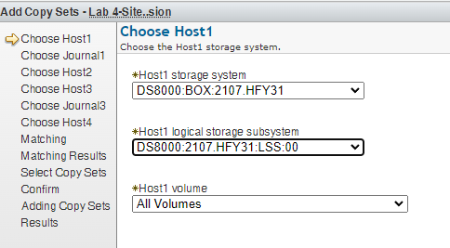
Copyset Build Panel – Idea for Simplification
Today
And every LSS must be assigned across the 4-site, 1 at a time to the end of the copyset build process.
Model of 1 idea – but I think it at least lends an idea to a parallel build method

