Slide 1
V9000 performance testing during Snapshot or incremental FlashCopy

Slide 2
Agenda
Our requirement
Business background and customer Requirement
Customer real I/O pattern from current V7000 iostats (Nifty is current IBM customer and they are using V7000 six box)
IBM internal test result

Slide 3
Our requirement
We hope either of the following item:
Improvement V9000 FlashCopy function
Reason for
Too large performance impact when take V9000 Snapshot or incremental FlashCopy
Performance degradation over 90% when take Snapshot.
Performance degradation over 60% when take incremental FlashCopy
Improvement point
Enable customize grain size to meet front I/O size
Change snapshot technology from Copy-on-Write(COW) to Redirect-on-Write(ROW)
Performance impact of ROW is smaller than COW.
To propose alternate storage system.
Provide X9000 storage system following schedule.
Provide beta version in 2015/11/1
Provide GA version in 2016/3/1
or
To support all SSD configuration on Spectrum Accelerate
->We understand XIV snapshot technology is using Redirect-on-Write(ROW).

Slide 4
Business background and customer requirement
Business background
Customer name：Nifty
Nifty is one of major cloud service provider in Japan.
They have over 1000 physical servers and 7PB storage.
They are using Netapp, HP 3PAR , IBM V7000(all SSD) and XIV(Gen2).
Major storage vendor is Netapp
Over 90% of their capacity is Netapp
They are planning new high speed storage service in Apr 16.
They are evaluating various flash storage system.(PureStorage, XtremIO, Solidfire)
Now IBM is proposing V9000 storage system to Nifty
4Q2015: To propose V9000(10TB) for test environment
1Q2016:To propose V9000(100TB) for production environment.
2Q2016 or later: To continue proposing V9000 with their growth of business. （Over 1PB / 3Years）
Customer requirement
Need Flash base storage for high speed storage cloud service.
Capacity is over 1PB.
Need point-in-time-copy for rapid recovery of data.
Performance impact taking point-in-time-copy less than 2-30%.

Slide 5
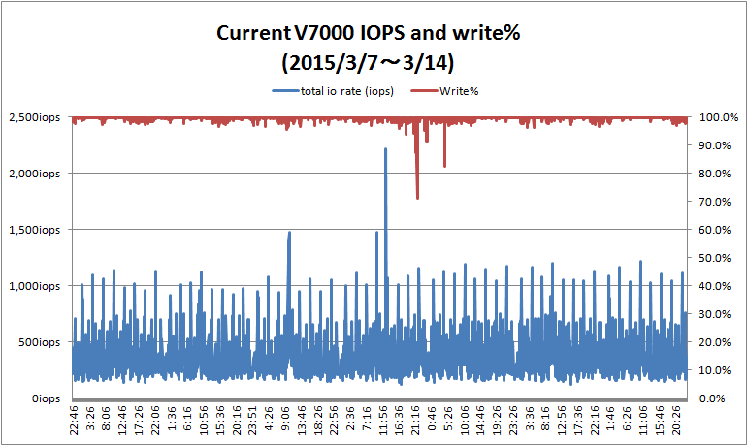
Customer real I/O pattern from V7000 iostats
The following graph is IOPS and write% of current Nifty V7000.
IOPS
Write%
 | Average IOPS | Maximum IOPS
CPU% | 4.0% | 26.2%
IOPS | 355iops | 2,214iops
MBPS | 4.6MBps | 77.5MBps
Avg response time | 0.8ms | 1.4ms
Read% | 0.8% | 0.1%
Block Size | 13.2KB | 35.9KB

Slide 6
Result of internal test.

Slide 7
Overview of Testing
Purpose of test and customer expectation.
To evaluate Flash base storage for high speed storage cloud service.
To measure performance impact when create point-in-time-copy.
Point –in-time-copy mean V9000 Snapshot and incremental FlashCopy.
Customer expectation is less than 30% when create point-in-time copy.
Test procedure
Test1:To measure the effect of customer I/O pattern.
Create I/O workload based on customer real I/O pattern.
Create Snapshot and incremental FlashCopy during above I/O work load.
To measure performance impact when create point-in-time-copy.
Test2:To measure the effect of sequential and random access.
Create I/O workload 100% sequential access and 25% random access.
Create Snapshot and incremental FlashCopy during above I/O work load.
To measure performance impact when create point-in-time-copy.

Slide 8
Test environment
Windows2008R2 EE SP1
Xeon 3.6GHz x 2CPU(16 Core)
64GB Memory
iometer
IOMeter parameter
Outstanding IO=4
Total workers = 16
Worker 1～8 -> DISK1
Worker 9～16 -> DISK2
Block size 36KB , Write99%, Rnd100% (This io-pattern is from current customer environment data)
FC
FC
FC
FC
FSSW
V9000(1.2TB x 12Modules)
FC
FC
FC
FC
FC
FC
FC
FC
Node1
Node2
Source
DISK1
2TB
DISK2
2TB
Taking V9000
Snapshot or incremental FlashCopy
Target

Slide 9
Test1: Customer IO Pattern = Block size 36KB , Write99%, Rnd100%
Benchmark Parameter(IO Meter)
Outstanding IO=4
Total workers = 16
Worker 1～8 -> DISK1
Worker 9～16 -> DISK2
Block size 36KB , Write99%, Rnd100% (This io-pattern is from current customer environment data)
Test case |  |  |  | Test Result
 |  |  |  | Performace during FlashCopy |  |  |  | Impact of Snapshot or incremental FlashCopy
Test Category | Grain size | Vdisk Cache | Placement of source volume and target volume | Read IOPS | Write IOPS | Read Latency | Write Latency | IOPS | Latency
SnapShot | 64KB | off | Each volume is same node (Souce volume is node1,Target volulme is node1) | 25 | 2,906 | 2ms | 21ms | 90% degrade | 10 times slower
 |  |  | Each volume is different node (Souce volume is node1,Target volulme is node2) | 25 | 2,760 | 2ms | 22ms | 91% degrade | 11 times slower
 | 256KB | off | Each volume is same node (Souce volume is node1,Target volulme is node1) | 20 | 2,495 | 2ms | 25ms | 92% degrade | 12 times slower
 |  |  | Each volume is different node (Souce volume is node1,Target volulme is node2) | 26 | 2,476 | 3ms | 25ms | 92% degrade | 12 times slower
Incremental FlashCopy | 64KB | off | Each volume is same node (Souce volume is node1,Target volulme is node1) | 51 | 4,935 | 3ms | 12ms | 83% degrade | 6 times slower
 |  | on |  | 102 | 10,737 | 39ms | 5ms | 64% degrade | 3 times slower
 | 256KB | on | Each volume is same node (Souce volume is node1,Target volulme is node1) | 59 | 4,910 | 3ms | 12ms | 83% degrade | 6 times slower

Slide 10
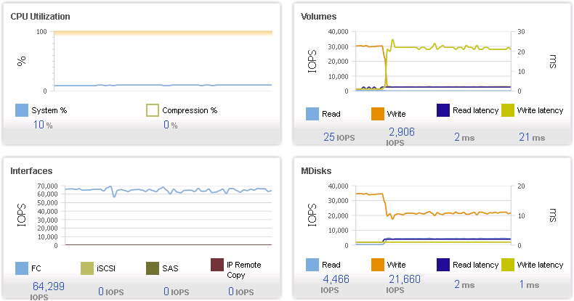
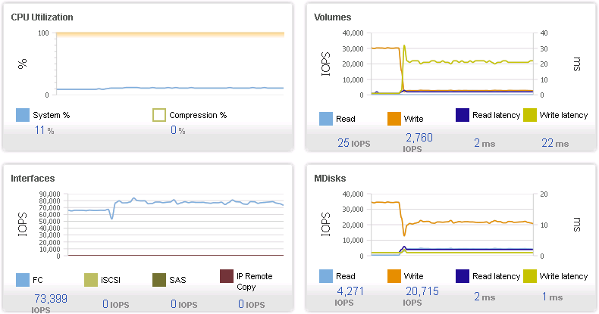
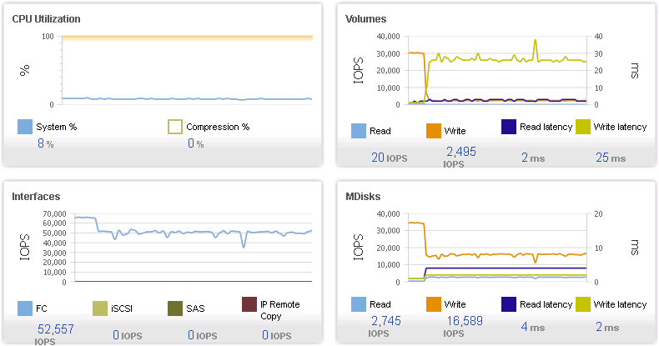
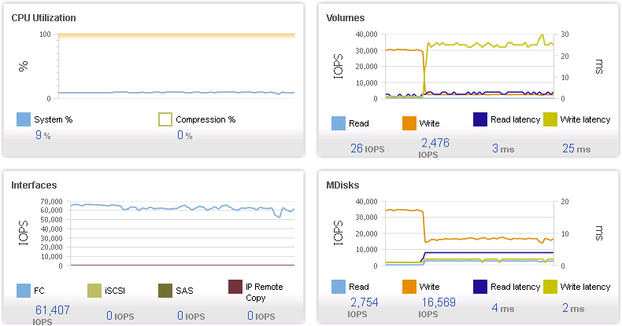
Test1:Detail of result (SnapShot)
Node1->Node1/Node2->Node2, grainsize=64KB
Node1->Node1/Node2->Node2, grainsize=256KB
Node1->Node2/Node2->Node1, grainsize=64KB
Node1->Node2/Node2->Node1, grainsize=256KB
startfc timing

Slide 11
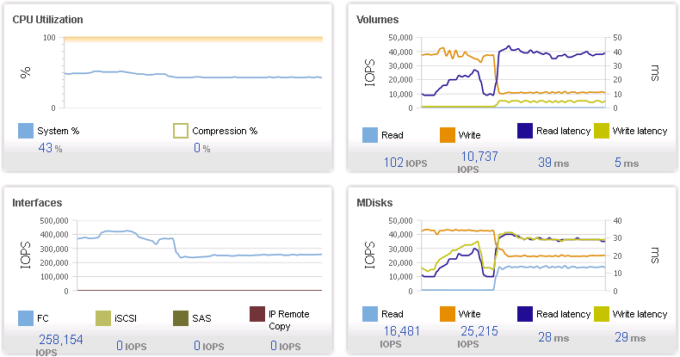
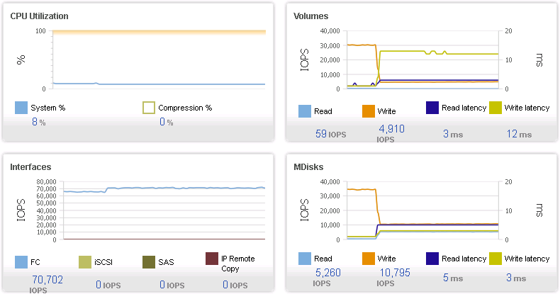
Test1:Detail of result (Incremental FlashCopy)
grainsize=64KB, Cache=Off
grainsize=256KB, Cache=Off
grainsize=64KB, Cache=On
startfc timing

Slide 12
Suggestion from WW Corporate Solution Architect, FlashSystem Solution Engineering (Rawley Burbridge)
The use case below with cache on is the scenario that we tested for Plenty of Fish. The issue at this point is that the random I/O is completely random in terms of locality. In a real-world application even with random I/O we would expect multiple I/Os to be contained within the same 64KB grain, reducing the number of grains that need to be copied.
One point of tuning or testing which you can try is to drift some of your write workload to be more sequential and then observe the impact to latency. With 100% sequential I would expect a very low impact to your latency, as the percentage of random increases then we start copying more grains and the latency will climb.
I am copying in the presentations I put together for our previous testing for your review. We started with random I/O, but after SVC development studied a dump file from a system that was already in place in the customer environment we were able to estimate that the workload was more sequential in nature, so we switched to a more sequential write operation.

Slide 13
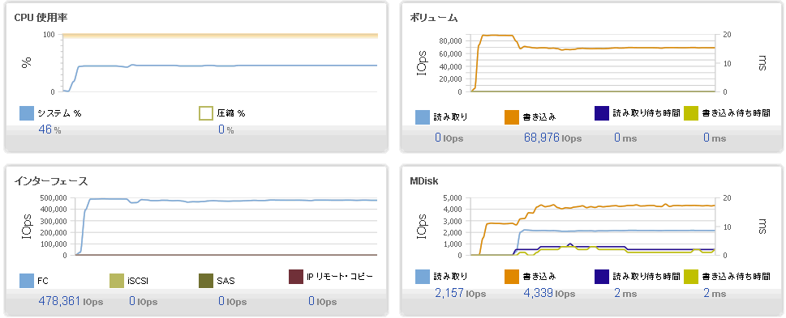
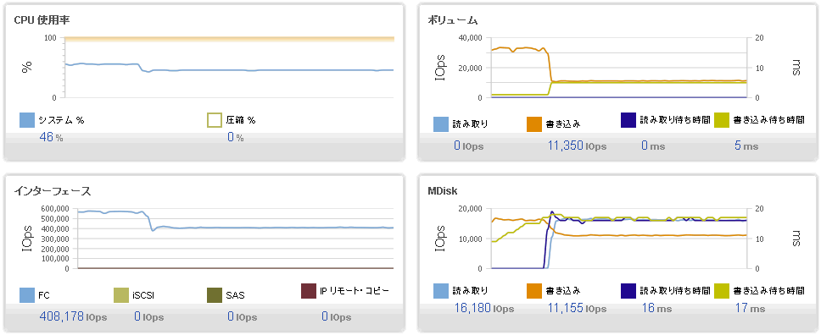
Test2:Compare sequential 100% and sequential 75%
■ Sequential 100% 8K Write 100% 2-Worker 32OutstandingIO# 2TBx2
20% performance degrade only sequential I/O
■ Sequential 75% 8K Write 100% 2-Worker 32OutstandingIO# 2TBx2
60% performance degrade include 25% random I/O

