Slide 1
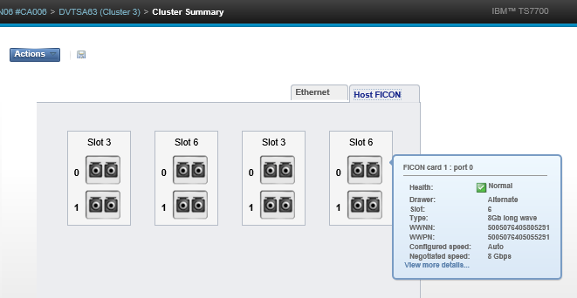
Enhancement Request for « VTS MI - Ficon status view »
By default the monitoring view of Ficon is as under:

Slide 2
Enhancement Request for « VTS MI - Ficon status view »
When having a quick check, the « green health » indicator may lead to a misunderstanding of the real Ficon port status.
Next page is a real customer observable view when customer experience some trouble with SAN fiber link that was stuck in “init mode”.
If we stop to the default view, everything is reported as “good” and there is no trouble on the VTS Ficon side;
If we develop the « view more details » having the « remote node id » empty , this leads us to understand that something is wrong even if check box is green.

Slide 4
Enhancement Request for « VTS MI - Ficon status view »
Enhancement request is for having the « check box » put in amber color when the information from remote node are empty or basically adding a comment like « all values for local and remote node must be filled in optimal running state ».
RCMS raised to troubleshoot issue (0133J99 /0133DM) this false check box status is damageable for:
Basic healthcheck monitoring for customer admin team “green check box” and “no event message” let them felt that all is fine.
If customer wasn't performing switch SAN migration, we are not sure they would have really seen the "ficon stuck in init mode " issue
Explain IBM support to understand and accept that something is wrong and obtain expected support, " waste of time in support process and some more customer dissatisfaction to handle “: everything “green” does not mean it is really OK

Slide 5
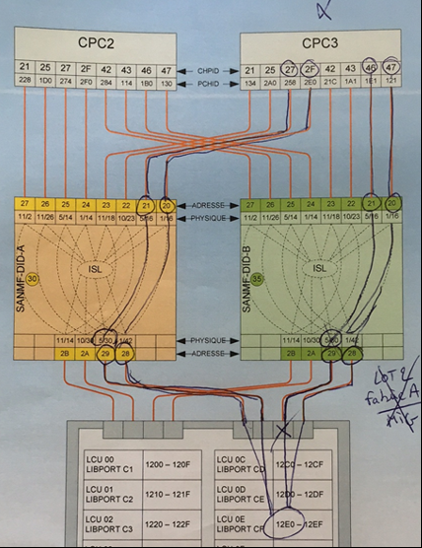
annex
Client’s Ficon connectivity
from Z to VTS

